Slide 1
Plan POC AMI

Slide 2
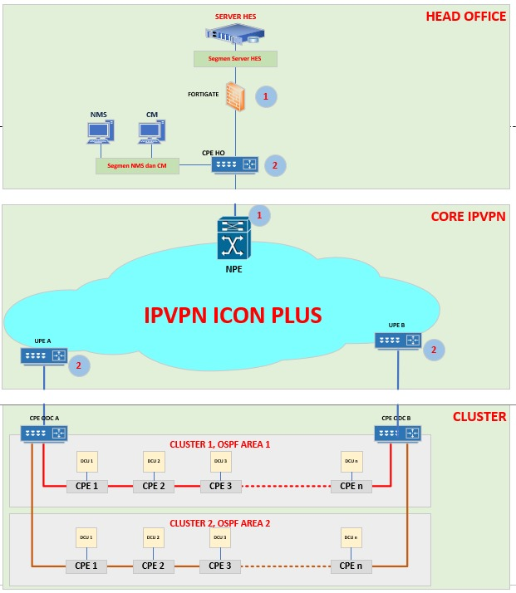
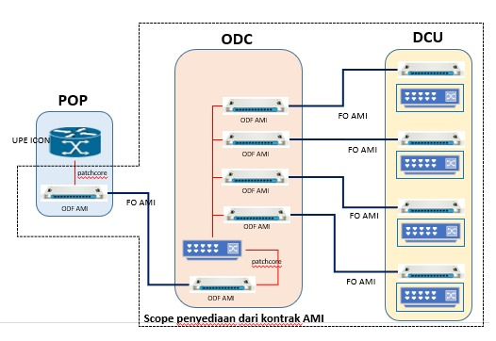
AMI Topology
L3 Router 1
L3 Router 2

Slide 3
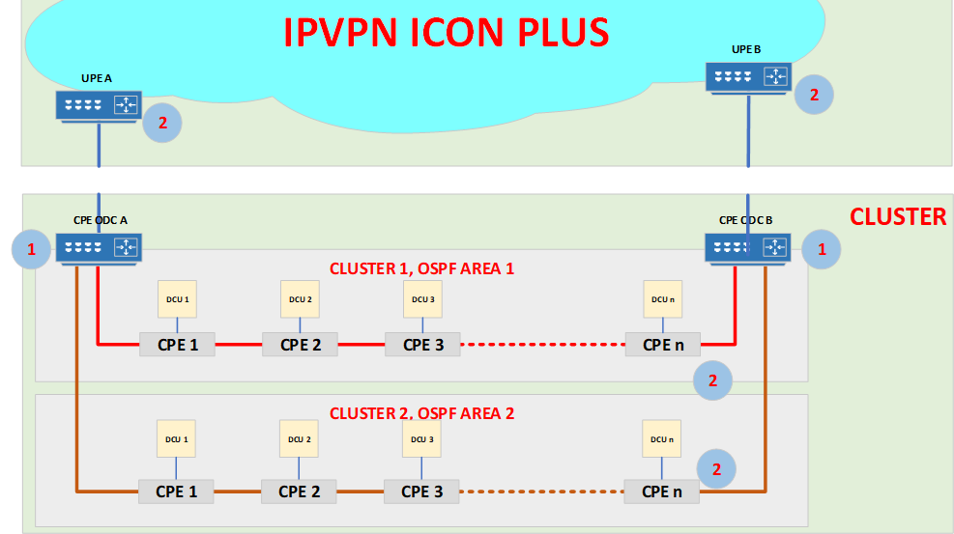
IP address Design
BHMA has 2880 SWs and DCUs. Each switch has 2 network segments except the last CPE in one link, which need 3 IP subnet.
Use 10.10.1.0/30 - 10.10.90.0/30, as shown in the file “IP address Design”. (Each subnet segment has 2 IP addresses.)
L3 Router 1
L3 Router 2
CPE1_IP1.1
CPEn_IP3.2
Link 1
Link 2
CCSI has 303 SWs and DCUs. Each switch has 2 network segments except the last CPE in one link, which need 3 IP subnet.
Use 10.20.1.0/30 - 10.20.11.0/30, as shown in the file “IP address Design”. (Each subnet segment has 2 IP addresses.)
CPE2_IP1.1
CPE3_IP1.1
CPEn_IP1.1
CPEn_IP1.2
CPE1_IP1.2
CPE2_IP1.2
CPE3_IP1.2
CPE 1
CPE 2
CPE 3
Link n
CPE n
CPEn_IP3.1
CPE1_IP2.1
CPE2_IP2.1
CPE3_IP2.1
CPEn_IP2.1
CPE1_IP2.2
CPE2_IP2.2
CPE3_IP2.2
CPEn_IP2.2
DCU1
DCU2
DCU3
DCUn
From left to right, every CPE(Switch) need to have 2 Subnet Segments, the last CPE in a link need to have 3 IP Subnet Segments

Slide 4
IP address Design
BHMA has 2880 SWs and DCUs. Each switch has 2 network segments except the last CPE in one link, which need 3 IP subnet.
Use 10.10.1.0/30 - 10.10.90.0/30, as shown in the file “IP address Design”. (Each subnet segment has 2 IP addresses.)
L3 Switch 1
L3 Switch 2
CPE1_IP1.1
CPEn_IP2.2
10.20.1.1
Link 1
Link 2
CCSI has 303 SWs and DCUs. Each switch has 2 network segments except the last CPE in one link, which need 3 IP subnet.
Use 10.20.1.0/30 - 10.20.11.0/30, as shown in the file “IP address Design”. (Each subnet segment has 2 IP addresses.)
CPE2_IP1.1
CPE3_IP1.1
CPEn_IP1.1
CPEn_IP1.2
CPE1_IP1.2
CPE2_IP1.2
CPE3_IP1.2
10.20.1.2
CPE 1
CPE 2
CPE 3
Link n
CPE n
CPE1_IP2.1
CPE2_IP2.1
CPE3_IP2.1
CPEn_IP2.1
CPEn_IP2.1
CPE1_IP2.2
CPE2_IP2.2
CPE3_IP2.2
CPEn_IP2.2
10.20.1.5
DCU1
DCU2
DCU3
DCUn
From left to right, every CPE(Switch) need to have 2 Subnet Segments, the last CPE in a link need to have 3 IP Subnet Segments
10.20.1.6

Slide 5
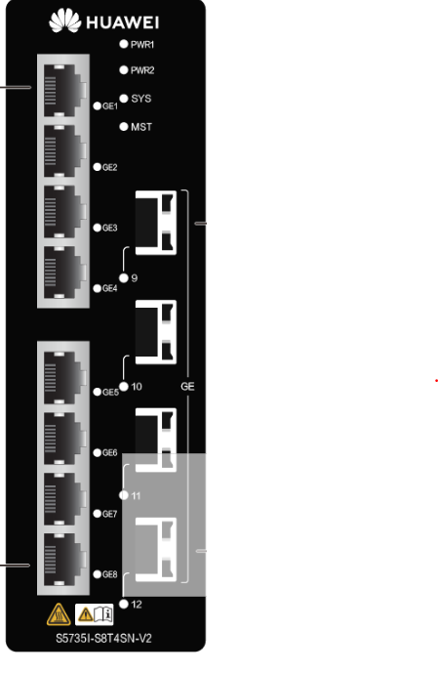
Port and VLAN Design
Use the first and last optical port
GE1/0/9
GE1/0/12
GE1/0/9
GE1/0/12
GE1/0/9
GE1/0/12
GE1/0/1
GE1/0/1
GE1/0/1
VLAN 100
VLAN 100
VLAN 100
DCU1
DCU2
DCU3
interface Vlanif100
description to DCU
ip address 10.10.2.1 255.255.255.252
interface GE1/0/1
port default vlan 100
#
Configuration Suggestion

Slide 6
OSPF Area Design
L3 Switch and UPE use OSPF area 0.
Each link use different OSPF erea, for example,
Link 1 use OSPF area 1
ospf 1
silent-interface Vlanif100
area 0.0.0.1
network 10.1.1.0 0.0.0.255
network 10.1.2.0 0.0.0.255
network 10.1.3.0 0.0.0.255
OSPF Area 0
OSPF Area 0
L3 Equipment 1
L3 Equipment 2
CPE1_IP1.1
Link 1
Link 2 use OSPF area 2
ospf 1
silent-interface Vlanif100
area 0.0.0.2
network 10.1.1.0 0.0.0.255
network 10.1.2.0 0.0.0.255
network 10.1.3.0 0.0.0.255
Link 2
CPE2_IP1.1
CPE3_IP1.1
CPEn_IP1.1
CPEn_IP1.2
CPE1_IP1.2
CPE2_IP1.2
CPE3_IP1.2
CPE 1
CPE 2
CPE 3
Link n
CPE n
CPE1_IP2.1
CPE2_IP2.1
CPE3_IP2.1
CPEn_IP2.1
Link n use OSPF area n
CPE1_IP2.2
CPE2_IP2.2
CPE3_IP2.2
CPEn_IP2.2
DCU1
DCU2
DCU3
DCUn
OSPF Area n

Slide 7
